Slide 1
Chapter 8 Files

Slide 2
Problem
Data stored in the program are temporary; they are lost when the program terminates.

Slide 3
Solution
To permanently store the data created in a program, you need to save them in a file on a disk or other permanent storage. The file can be transported and can be read later by other programs.

Slide 4
Objectives
To use text files to store large data sets
To open a file, read/write data from/to a file
To access online data sources in CSV format
To analyze real data.

Slide 5
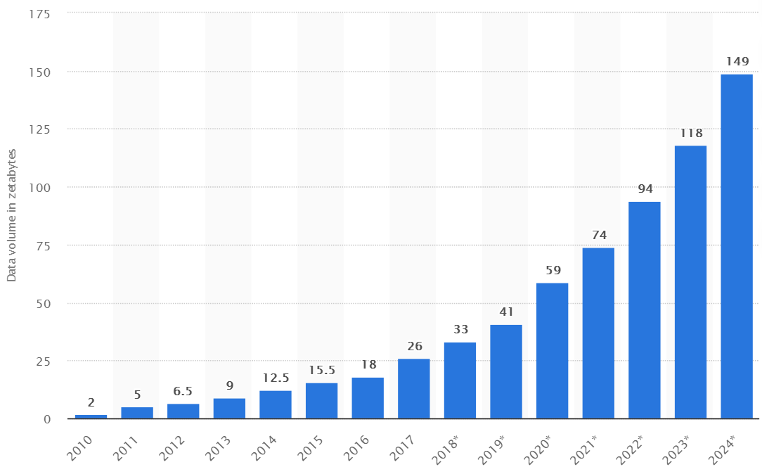
Volume of Data Created Worldwide
The total amount of data created, captured, copied, and consumed in the world is forecast to increase rapidly, reaching 59 zettabytes in 2020.
Notes:
Zettabyte = 1 billion Terabyte

Slide 6
Big Data
Big data is extremely large data sets that may be analyzed computationally to reveal patterns, trends, and associations, especially relating to human behavior and interactions.
What kinds of degrees can I earn in big data?
Probability and Statistics.
Computational Stochastic Modeling.
Business Data Warehouses and Dimensional Modeling.
Machine Learning and Data Mining.
Data Analysis and Visualization.

Slide 7
Using Files for Large Data Sets
Python provides us with a number of powerful collections to store and manipulate data.
As the amount of data gets larger, it becomes more and more difficult to fill these collections for later processing.
Large data sets are usually found in data files that are prepared ahead of time.

Slide 8
Using Files for Large Data Sets (cont’d.)
We can read such data from the file and fill our collections for later processing.
In Python, we must open files before we can use them and close them when we are done with them.
Python has functions that can be used to open and close files.
Once a file has been opened it becomes a Python object just like all other data.
When we are finished with the file, we can close it by using the close method.
After the file is closed, any further attempts to use file reference will result in an error.

Slide 9
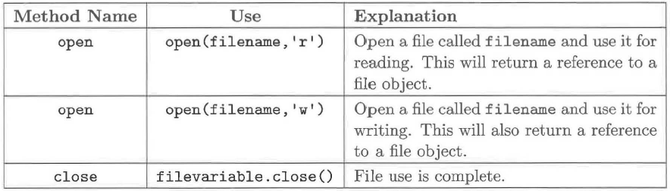
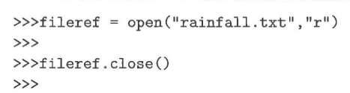
Opening and Closing Files in Python
Notes:
readRainfall

Slide 10
Iterating Over Lines in a File
Suppose we have a text file called rainfall.txt that contains data representing the total annual rainfall (in inches) for 25 towns in Iowa.
Akron 25.81
Albia 37.65
Algona 30.69
Allison 33.64
Alton 27.43
AmesW 34.07
AmesSE 33.95
Anamosa 35.33
Ankeny 33.38
Atlantic 34.37
Audubon 33.41
Beaconsfield 35.27
Bedford 36.35
BellePlaine 35.81
Bellevue 34.35
Blockton 36.28
Bloomfield 38.02
Boone 36.30
Brighton 33.59
Britt 31.54
Buckeye 33.66
BurlingtonKBUR 37.94
Burlington 36.94
Carroll 33.33
Cascade 33.48

Slide 11
Iterating Over Lines in a File (cont’d.)
Although it would be possible to consider entering this data by hand each time it is used, you can imagine that such a task would be time-consuming and error-prone.
In addition, it is likely that there could be data from many more towns.
We can use this file as input in a program that will do some data processing.

Slide 12
Iterating Over Lines in a File (cont’d.)
In the program, we will read each line of the file and print it with some additional text.
Because text files are sequences of lines of text, we can use the for loop to iterate through each line of the file.
A line of a file is defined to be a sequence of characters up to and including a special character called the newline character.

Slide 13
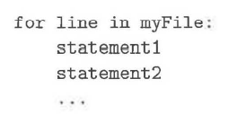
Iterating Over Lines in a File (cont’d.)
As the for loop iterates through each line of the file, the loop variable will contain the current line of the file as a string of characters.

Slide 14
Iterating Over Lines in a File (cont’d.)
To process all of our rainfall data, we use a for loop to iterate over the lines of the file.
Using the split method, we can break each line into a list containing the city code and the rainfall amount.
We can then take these values and construct a simple sentence,

Slide 15
Iterating Over Lines in a File (cont’d.)
rainfile = open("rainfall.txt","r")
for aline in rainfile:
values = aline.split()
print(values[0], "had",values[1],"inches of rain.")
rainfile.close()
Akron had 25.81 inches of rain.
Albia had 37.65 inches of rain.
Algona had 30.69 inches of rain.
Allison had 33.64 inches of rain.
Alton had 27.43 inches of rain.
AmesW had 34.07 inches of rain.
AmesSE had 33.95 inches of rain.
Anamosa had 35.33 inches of rain.
Ankeny had 33.38 inches of rain.
Atlantic had 34.37 inches of rain.
Audubon had 33.41 inches of rain.
Beaconsfield had 35.27 inches of rain.
Bedford had 36.35 inches of rain.
BellePlaine had 35.81 inches of rain.
Bellevue had 34.3
5 inches of rain.
Blockton had 36.28 inches of rain.
Bloomfield had 38.02 inches of rain.
Boone had 36.30 inches of rain.
Brighton had 33.59 inches of rain.
Britt had 31.54 inches of rain.
Buckeye had 33.66 inches of rain.
BurlingtonKBUR had 37.94 inches of rain.
Burlington had 36.94 inches of rain.
Carroll had 33.33 inches of rain.
Cascade had 33.48 inches of rain.

Slide 16
import statistics
def makeRainfallList():
rainfallFile = open("rainfall.txt","r")
rainfallList = [ ]
for aline in rainfallFile:
vlist = aline.split()
rainfallList.append(float(vlist[1]))
return rainfallList
rainfallList = makeRainfallList()
print('RainFallList:',rainfallList)
print ( 'Range:', max(rainfallList) - min(rainfallList) )
print ( 'Max:',max(rainfallList) )
print ( 'Min:',min(rainfallList) )
print ( 'Mean:',statistics.mean(rainfallList) )
print ( 'Median:',statistics.median(rainfallList) )
print ( 'Mode:',statistics.mode(rainfallList) )
print ( 'StandardDev',statistics.stdev(rainfallList) )
RainFallList: [25.81, 37.65, 30.69, 33.64, 27.43, 34.07, 33.95, 35.33, 33.38, 34.37, 33.41, 35.27, 36.35, 35.81, 34.35, 36.28, 38.02, 36.3, 33.59, 31.54, 33.66, 37.94, 36.94, 33.33, 33.48]
Range: 12.210000000000004
Max: 38.02
Min: 25.81
Mean: 34.1036
Median: 34.07
Mode: 25.81
StandardDev 2.9256849340510565
Notes:
makeRainfallList

Slide 17
Writing a File
Let's think about another example of file processing: converting our file from data about rainfall in inches to data about rainfall in centimeters.
This will require that we read the file contents as before, but, instead of printing a message, we will do some computation and then write the results back to another file.

Slide 18
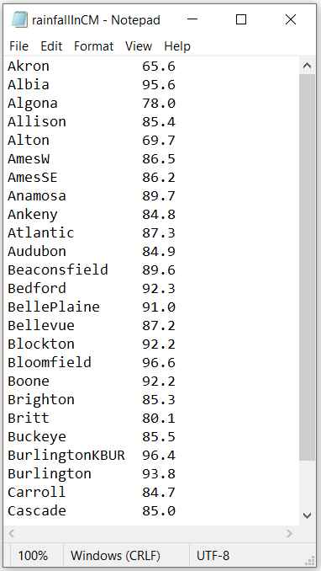
Writing a File (cont’d.)
rainfile = open("rainfall.txt","r")
outfile = open("rainfallInCM.txt","w")
for aline in rainfile:
values = aline.split()
inches = float(values[1])
cm = 2.54 * inches
s = "{0:16s}{1:.1f}".format(values[0], cm )
outfile.write(s +"\n")
rainfile.close()
outfile.close()
Notes:
inchCm

Slide 19
Writing a File (cont’d.)
The write statement does all of the work to create a new line in the output file.
Note that it can add only a single string to the file each time it is used.
For this reason, we need to use string concatenation to build up the line piece by piece.
The entire line is completed by adding a newline character.

Slide 20
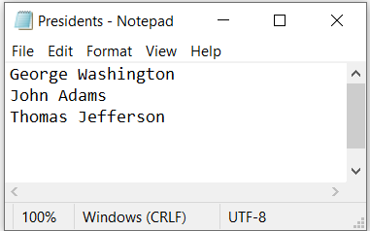
Writing a File Example
def main():
# Open file for output
outputFile = open("Presidents.txt", "w")
# Write data to the file
outputFile.write("George Washington\n")
outputFile.write("John Adams\n")
outputFile.write("Thomas Jefferson") #Write Thomas Jefferson
outputFile.close() # Close the output file
main() # Call the main function

Slide 21
Alternative File-Reading Methods
In addition to the for loop, Python provides three methods to read data from the input file.
The readline method reads one line from the file and returns it as a string.
The string returned by readline will contain the newline character at the end.
This method returns the empty string when it reaches the end of the file.

Slide 22
Alternative File-Reading Methods (cont’d.)
The readlines method returns the contents of the entire file as a list of strings, where each item in the list represents one line of the file.
It is also possible to read the entire file into a single string with read.

Slide 23
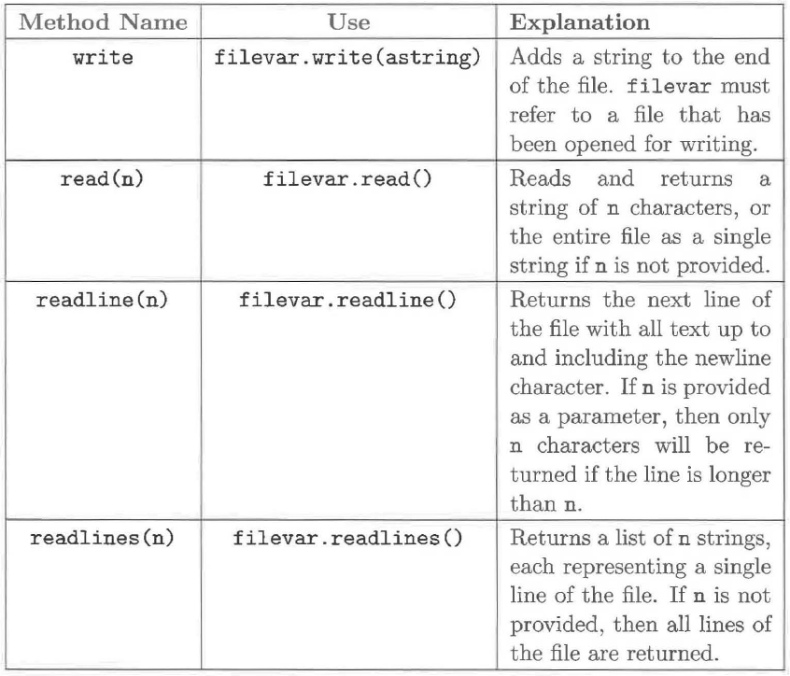

Slide 24
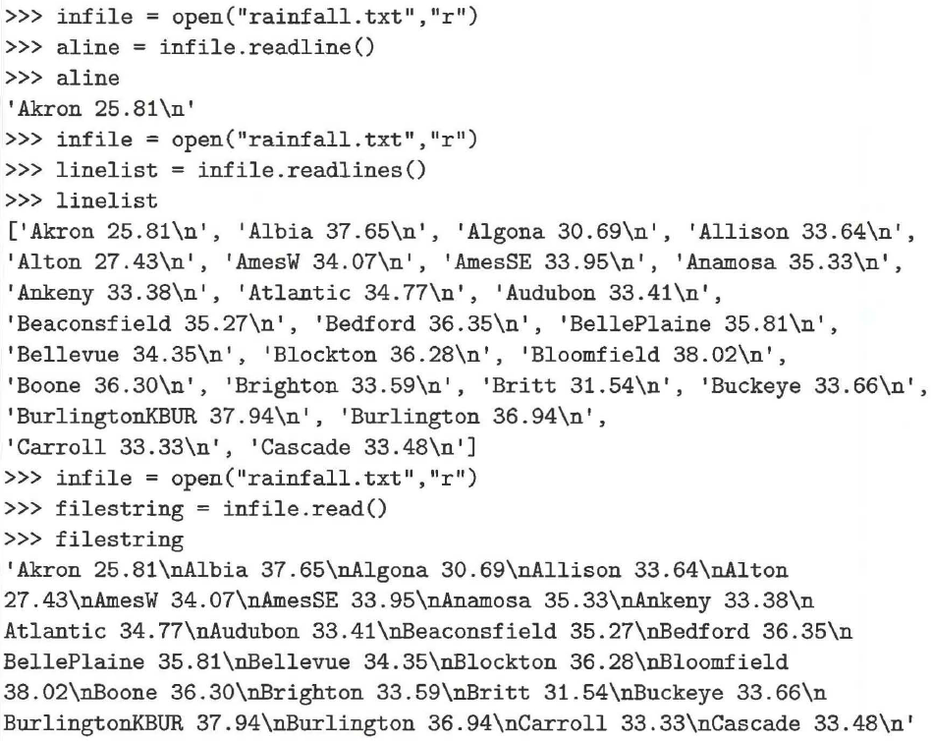

Slide 25
def main():
# Open file for input
inputFile = open("Presidents.txt", "r")
print("Using read(): ")
print(inputFile.read()) # Read all in the file
inputFile.close() # Close the input file
# Open file for input
inputFile = open("Presidents.txt", "r")
print("Using read(number): ")
s1 = inputFile.read(4) # Read 4 characters to s1
print(s1)
s2 = inputFile.read(8) # Read 15 characters to s2
print(s2)
inputFile.close() # Close the input file
# Open file for input
inputFile = open("Presidents.txt", "r")
print("\nUsing readline(): ")
line1 = inputFile.readline() # Read a line
line2 = inputFile.readline()
line3 = inputFile.readline()
print(line1)
print(line2)
print(line3)
inputFile.close() # Close the input file
# Open file for input
inputFile = open("Presidents.txt", "r")
print("Using readlines(): ")
print(inputFile.readlines())
inputFile.close() # Close the input file
main() # Call the main function
Using read():
George Washington
John Adams
Thomas Jefferson
Using read(number):
Geor
ge Washi
Using readline():
George Washington
John Adams
Thomas Jefferson
Using readlines():
['George Washington\n', 'John Adams\n', 'Thomas Jefferson\n']

Slide 26
Alternative File-Reading Methods (cont’d.)
Note that we need to reopen the file before each read so that we start from the beginning.
Each file has a marker that denotes the current read position in the file.
Anytime one of the read methods is called, the marker is moved to the character immediately following the last character returned.
In the case of readline, this moves the marker to the first character of the next line in the file.
In the case of read or readlines, the marker is moved to the end of the file.

Slide 27
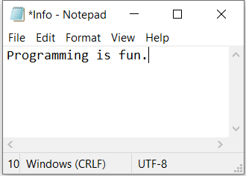
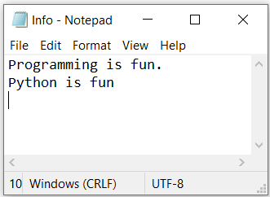
Appending Data
You can use the a mode to open a file for appending data to the end of an existing file.
Assume the Info.txt file contains the text “Programming is fun.”
The program opens file Info.txt using the a mode for appending data to the file
through the file object outfile. The position of the curser after the file is opened is after the period. The position of the curser after
Writing ("\nPython is fun\n” is at the end of the file.
def main():
# Open file for appending data
outputFile = open("Info.txt", "a")
outputFile.write("\nPython is fun\n")
outputFile.close() # Close the input file
main() # Call the main function

Slide 28
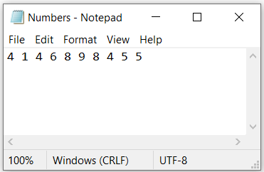
Write and Read Data
from random import randint
def main():
# Open file for writing data
outputFile = open("Numbers.txt", "w")
for i in range(10):
outputFile.write(str(randint(0, 9)) + " ")
outputFile.close() # Close the file
# Open file for reading data
inputFile = open("Numbers.txt", "r")
s = inputFile.read() # Read all data to s
L = s.split()
numbers = []
for x in L:
numbers.append(int(x))
for number in numbers:
print(number, end = " ")
inputFile.close() # Close the file
main() # Call the main function
4 1 4 6 8 9 8 4 5 5

Slide 29
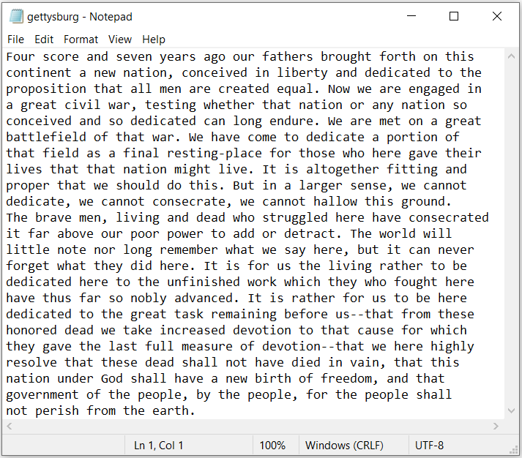
Counting Each Letter in a File
The problem in this case study is to write a program that prompts the user to enter a
filename and counts the number of occurrences of each letter in the file regardless of case.

Slide 30
def countLetters(line, counts):
for ch in line:
if ch.isalpha(): # Test if ch is a letter
counts[ord(ch) - ord('a')] += 1
def main():
filename = input("Enter a filename: ").strip()
inputFile = open(filename, "r") # Open the file
counts = 26 * [0] # Create and initialize counts
for line in inputFile:
# Invoke the countLetters function to count each letter
countLetters(line.lower(), counts)
inputFile.close() # Close file
# Display results
print("Letter","Count")
for i in range(len(counts)):
if counts[i] != 0:
print(chr(i + ord(‘A')),"\t", counts[i])
main() # Call the main function
Enter a filename: gettysburg.txt
Letter Count
A 102
B 14
C 31
D 58
E 165
F 27
G 28
H 80
I 68
K 3
L 42
M 13
N 77
O 93
P 15
Q 1
R 79
S 44
T 126
U 21
V 24
W 28
Y 10

Slide 31
Reading Data from the Internet
Internet sites often provide large sets of data that can be downloaded for analysis. These data sets are usually made available in several formats: text files in CSV (comma-separated values) format or in JSON (JavaScript Object Notation), which is a standardized data transfer format with self-identifying tags.

Slide 32
Reading Data from the Internet (cont’d.)
The U.S. Geological Survey (USGS) website makes raw data available for earthquakes that occur around the world. It is also possible to filter the data to include only earthquakes with minimum magnitudes or only earthquakes that occurred within a specific time period.
The data about each earthquake includes the date and time, location, magnitude, depth of the quake, and other identifying data.

Slide 33
Using CSV Files
One format that the USGS provides for downloading earthquake data is CSV.
In CVS format, the first line of the USGS file includes metadata which is descriptive information about the data. The remaining lines in the USGS file provide the data for the earthquakes, one per line.
As the name CSV implies, data fields are separated by a comma. The positions of the names in the first line correspond to the positions of the data in each succeeding line. Optionally, all data fields can be surrounded by quotes, but at minimum, data containing spaces or commas are surrounded by quotes.

Slide 34
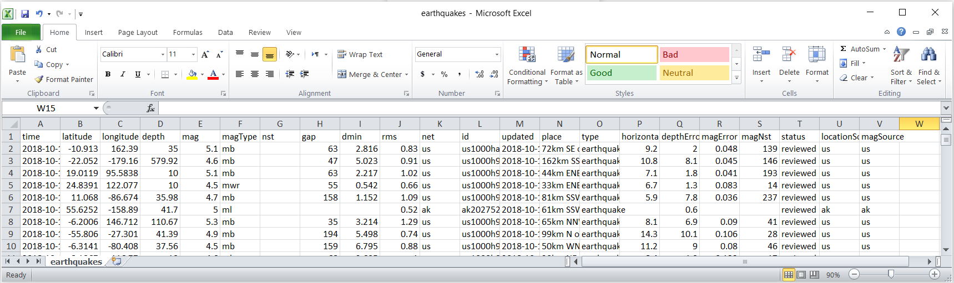
Using CSV Files (cont’d.)
The first few lines of the earthquakes.csv file.

Slide 35
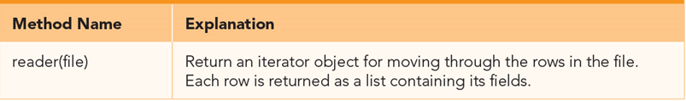
Using CSV Files (cont’d.)
Python’s csv module makes it easy to read and process CSV files.
The module provides a reader method that can be used to interpret each line of the CSV file.
The reader method returns an iterator, which is an object that can return one item at a time from a group. In our case, the iterator will return one line at a time from the file as a list of values.

Slide 36
Using CSV Files (cont’d.)
The csvReader object converts each line from CSV format to a list of strings.
import csv
inFile = open("earthquakes3.csv", "r")
csvReader =csv.reader(inFile) #pass file to csv reader
for line in csvReader: #read each line
print(line)
print()
['time', 'latitude', 'longitude', 'depth', 'mag', 'magType', 'nst', 'gap', 'dmin', 'rms', 'net', 'id', 'updated', 'place', 'type', 'horizontalError', 'depthError', 'magError', 'magNst', 'status', 'locationSource', 'magSource']
['2018-10-10T16:18:27.120Z', '-10.9133', '162.3903', '35', '5.1', 'mb', '', '63', '2.816', '0.83', 'us', 'us1000ha2w', '2018-10-10T16:37:38.040Z', '72km SE of Kirakira, Solomon Islands', 'earthquake', '9.2', '2', '0.048', '139', 'reviewed', 'us', 'us']
['2018-10-10T11:11:03.170Z', '-22.0519', '-179.1596', '579.92', '4.6', 'mb', '', '47', '5.023', '0.91', 'us', 'us1000h9x5', '2018-10-10T11:32:05.040Z', '162km SSW of Ndoi Island, Fiji', 'earthquake', '10.8', '8.1', '0.045', '146', 'reviewed', 'us', 'us']

Slide 37
Using a while Loop to Process Data
When working with real data, it is often necessary to perform some basic data processing to get the data into a format that works for our purposes.
We will use a large data file that contains detailed data pertaining to earthquake occurrences around the world.
Our first task in analyzing this real data source is to process the data file by extracting the pertinent data from the file and storing it in an appropriate collection.
For our purposes here, we need to process the file and create a list of magnitude.

Slide 38
Using a while Loop to Process Data (cont’d.)
Let’s give some thought to what we need to do to create a list of the magnitudes for the earthquakes in the file.
First, we should find the column that contains the magnitude data.
We can determine that by searching the metadata line, counting each name until we find the string 'mag'.
After we find the string we are looking for, we do not need to look at any of the remaining data names.
A while loop will be ideal for this type of processing.
The while loop is useful when you may not know how much data you want to process at the start.

Slide 39
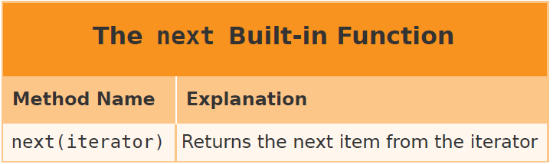
Using a while Loop to Process Data (cont’d.)
We will use a while loop to find the column containing the earthquakes’ magnitudes.
We need only to read the first line that contains the title. We can do that using the built-in function: next.
The next function returns the next item from an iterator. The iterator in this case is the csvReader.

Slide 40
Using a while Loop to Process Data (cont’d.)
import csv
inFile = open("earthquakes.csv", "r")
csvReader = csv.reader(inFile) #pass file to csv reader
titles = next(csvReader) #read first line with titles
print(titles)
colNum = 0
while titles[colNum] != "mag":
colNum = colNum + 1
print("The magnitude is found in column", colNum)
['time', 'latitude', 'longitude', 'depth', 'mag', 'magType', 'nst', 'gap', 'dmin', 'rms', 'net', 'id', 'updated', 'place', 'type', 'horizontalError', 'depthError', 'magError', 'magNst', 'status', 'locationSource', 'magSource']
The magnitude is found in column 4

Slide 41
Using a while Loop to Process Data (cont’d.)
Now that we found the column name, we can improve our loop in two ways.
First, we can let the user pass the data name as a parameter. This will make the function reusable for any earthquake numeric data.
Second, in our loop, we need to check for two conditions: (1) We have not found the data name or (2) we have not reached the end of the list. If either condition is False, we exit the loop.
Assuming that the data name we are looking for is dataName, the condition now becomes:
The order in which we check these two conditions is critical.

Slide 42
Using a while Loop to Process Data (cont’d.)
def makeDataList(dataName,fileName):
inFile = open(fileName, 'r')
dataList = []
csvReader = csv.reader(inFile) #get iterator
titles = next(csvReader) #read first line
colNum = 0 #search for colName
while colNum < len(titles) and titles[colNum] != dataName:
colNum = colNum + 1
if colNum == len(titles): #was titles end reached?
print("Error:", dataName, "not found.")
else:
for line in csvReader:
dataList.append(float(line[colNum]))
return dataList
magList = makeDataList("mag","earthquakes.csv")
print("Number of records:",len(magList))
print("First 10 Mag:")
for i in range(10):
print(magList[i],end=" ")
print()
depthList = makeDataList("depth","earthquakes.csv")
print("First 10 depth:")
for i in range(10):
print(depthList[i],end=" ")
print()
print (makeDataList("notATitle","earthquakes.csv"))
Number of records: 501
First 10 Mag:
5.1 4.6 5.1 4.5 4.7 5.0 5.3 4.9 4.5 4.6
First 10 depth:
35.0 579.92 10.0 10.0 35.98 41.7 110.67 41.39 37.56 10.0
Error: notATitle not found.
[]

Slide 43
Statistics from the Earthquake Data
We can now use basic statistics functions to learn about the earthquakes that have occurred during this period of time.
uses the makeDataList function to create a list of magnitudes and then uses statistical functions to compute values for the minimum, maximum, mean, mode, median, and standard deviation.
The reason for this difference between the mean and the mode becomes apparent when we look at our frequency table.
import statistics
magList = makeDataList("mag")
print('Max:',max(magList))
print('Min:',min(magList))
print('Mean:',statistics.mean(magList))
print('Median:',statistics.median(magList))
print('MultiMode:',statistics.multimode(magList))
print('Stdev:',statistics.stdev(magList))
Max: 7.5
Min: 4.5
Mean: 4.879041916167664
Median: 4.8
MultiMode: [4.5]
Stdev: 0.387994690993989

Slide 44
Frequency Table for Earthquake Magnitude Data
import makeDataList
def frequencyTable(aList):
countDict = {}
for item in aList:
if item in countDict:
countDict[item] = countDict[item] + 1
else:
countDict[item] = 1
itemList = list(countDict.keys())
itemList.sort()
print("ITEM", "FREQUENCY")
for item in itemList:
print("{0:4.2} {1:6}".format(item, countDict[item]))
magList = makeDataList.makeDataList("mag","earthquakes.csv")
frequencyTable(magList)
ITEM FREQUENCY
4.5 101
4.6 81
4.7 55
4.8 43
4.9 52
5.0 34
5.1 40
5.2 18
5.3 18
5.4 21
5.5 7
5.6 7
5.7 7
5.8 5
5.9 4
6.0 3
6.1 1
6.3 1
6.5 1
6.6 1
7.5 1

Slide 45
Frequency Table for Earthquake Magnitude Data (cont’d.)
Although most of the earthquakes reported during the period were the minimum recorded by this report, some very strong earthquakes occurred that have magnitudes of 6 and greater. Thus, for this data, the mean is shifted up by these infrequent but strong events.

Slide 46
Correlating Data from Internet
Correlation measures the strength and direction of the relationship between two variables.
Correlation measures the tendency of two variables to increase or decrease at the same time.
This measure is often called the correlation coefficient.
Returning to the earthquake data, we could ask the question: “Is the magnitude of an earthquake correlated with its depth?”

Slide 47
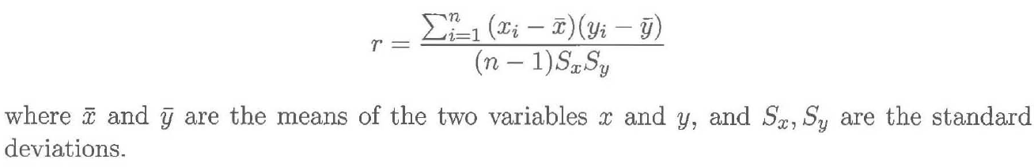
Correlating Data from Internet (cont’d.)
Although several algorithms are available for calculating a correlation coefficient for a sample, we will use the Pearson correlation coefficient.
The formula for calculating this coefficient is

Slide 48
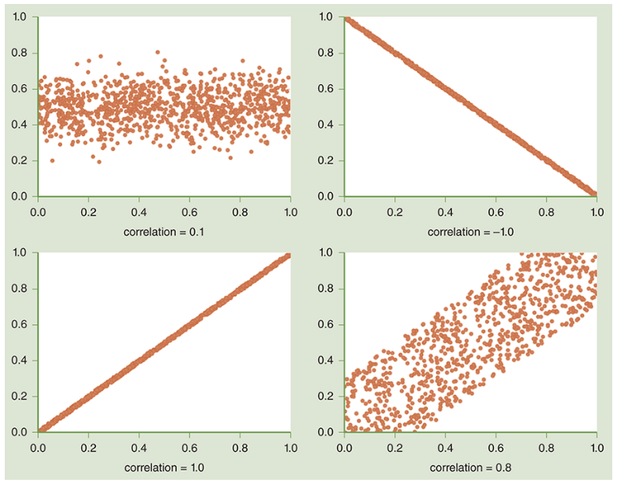
Some of the correlational values that are possible for two variables.

Slide 49
Correlating Data from Internet (cont’d.)
The values from one variable are used as the x coordinate, and the values from the other variable are used as the y coordinate.
Each of the four examples shows 1000 pairs of values of the x, y variables.
When the variables are highly correlated, they nearly form a line, as shown in the bottom left and top right boxes.
When they are not correlated, the points form a cloud or a wide band, as shown in the top left and bottom right boxes.
A value of 1.0 indicates that the two variables are positively correlated—that is, the values of the variables move in the same direction.
A value of −1.0 indicates that the two variables are negatively correlated—that is, the values of the variables move in opposite directions.
A value of 0.0 indicates that there is no correlation between the two values.

Slide 50
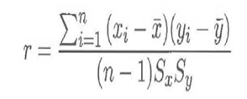
Correlating Data from Internet (cont’d.)
Function correlation implements the Pearson correlation formula. The two parameters xList and yList represent the values that we want to correlate. The two lists have the same length, and they are parallel, which means that the x value at a particular position in the list and a y value at the same position represent a single x, y data point. For example, using our earthquake data, the values at a particular index in xList and yList represent the magnitude and another measure for a particular earthquake.
def correlation(xList, yList):
import statistics
xBar = statistics.mean(xList)
yBar = statistics.mean(yList)
xStd = statistics.stdev(xList)
yStd = statistics.stdev(yList)
num = 0.0
for i in range(len(xList)):
num = num + (xList[i] - xBar) * (yList[i] - yBar)
corr = num / ((len(xList) - 1) * xStd * yStd)
return corr

Slide 51
Correlating Data from Internet (cont’d.)
We run the correlation function between the magnitudes and depth of earthquakes, extracting the data from the CSV file. We find a result of 0.03, which means that the two values are not correlated.
import makeDataList
magList = makeDataList.makeDataList("mag","earthquakes.csv")
depthList = makeDataList.makeDataList("depth","earthquakes.csv")
print("Correlation between magnitudes and depth of earthquakes:")
print(correlation (magList, depthList))
Correlation between magnitudes and depth of earthquakes:
0.028414472374925413

